Slide 1


Model Calibration
EWRI Congress 2025
EPA SWMM5 Technical Workshop
Anchorage AK, May 18, 2025

Slide 2
Outline
Model credibility (calibration, validation, and verification)
Suggested model calibration methodology
Monitoring program data review
Project examples

Slide 3

Model Credibility
EWRI Congress 2025, EPA SWMM5 Workshop -- Model Calibration
Notes:
EWRI Congress 2025, Technical Workshop
EPA SWMM5
Anchorage AK, May 18, 2025

Slide 4
Stormwater Modeling in Perspective
A model is only an approximation of reality, results must be checked & verified
Achieving a “perfect” calibration might not be worth the effort
Consider “setting with some degree of intelligence” versus “calibration”
“All models are wrong, some are useful” – G. Box
“The scientist is interested in the right answer, the engineer in the best answer now” – H. Golder
“All these prepositions are empirical. It is not possible to prove them mathematically… Fortunately, nature is not aware of this.” – Johnstone and Cross, 1949

Slide 5
Model Credibility
Calibration/validation/verification provides a reality check
Compare results to observed behavior under a variety of conditions:
Calibration – measurements for a series of (often) smaller storm events
Validation – measurements or related information for small & large events
Verification – anecdotal information for the larger, less frequent design events
Benefits of a calibrated model include:
To the modeler...
Better understanding of the modeled system
Improved confidence and reliability in model results
To the general public that we serve...
Model credibility
Wider acceptance of recommendations

Slide 6
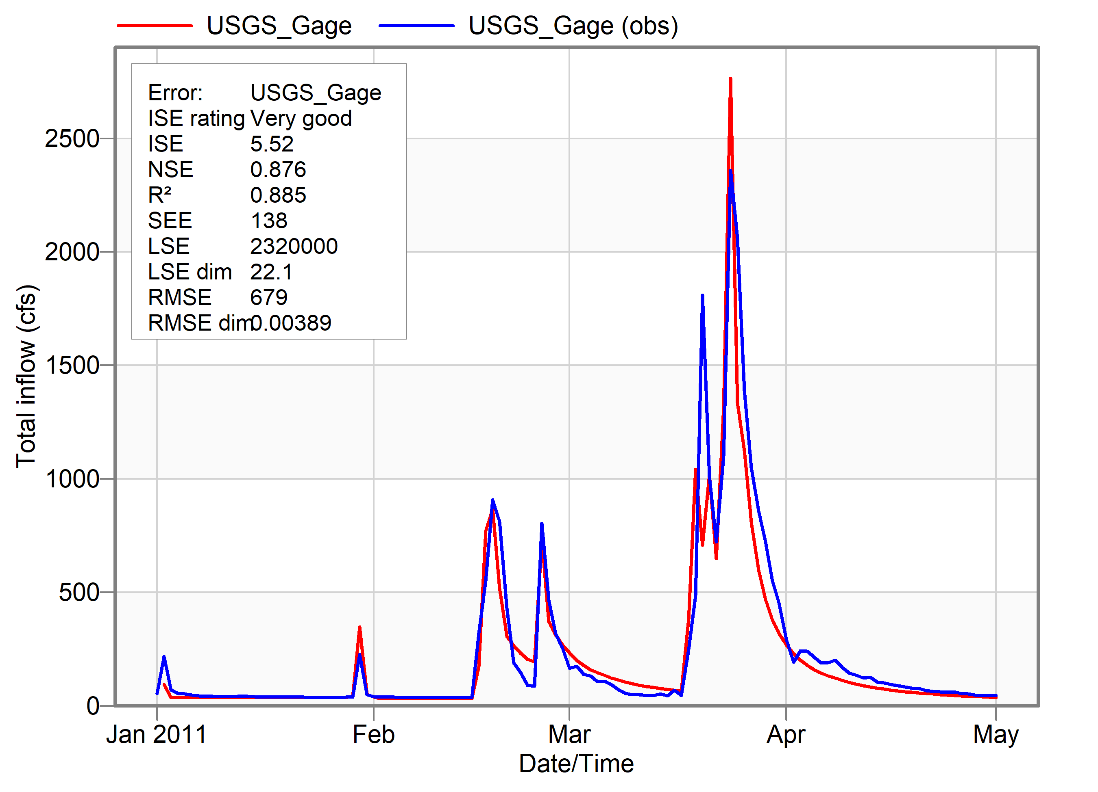
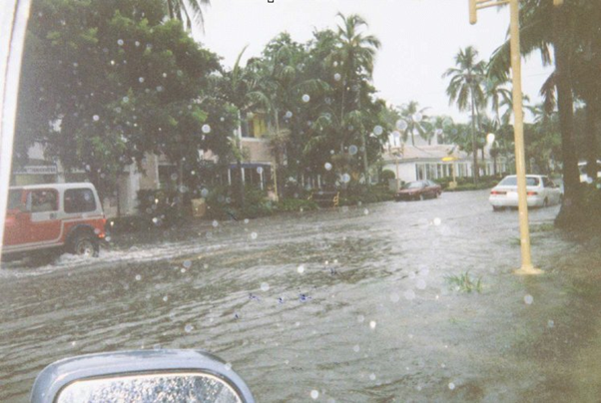
Model Credibility
Consider… Accurate Analysis vs. Acceptable Results
It’s not enough to be technically accurate, public officials and residents need assurance that your model produces acceptable results
Showing results that match a memorable event will help to gain confidence more easily
Model node3040
Max. predicted road flooding depth = 0.4ft for Sept 18-21 storm

Slide 7
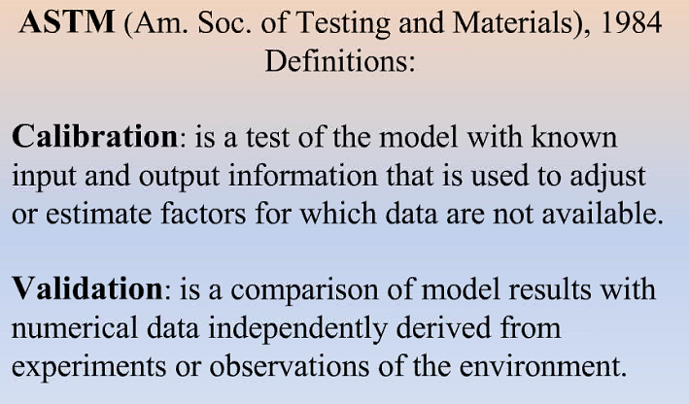
Calibration Defined
Rather than force-fitting the input parameters, several tasks are involved:
Examine/verify measured data
Conduct sensitivity analysis of model parameters
Develop calibration strategy and apply it
Validate model with additional information from historical events
Verify model for local design storm events
Recognize that calibration results are only as accurate as rain/flow measurements
Beware spending too much effort calibrating to bad rainfall or flow data!

Slide 8
Sensitivity Analysis
Definition: input parameters are independently and systematically varied to identify incremental change
Sensitivity analyses will:
Help modelers understand how their model responds to changes in input parameters
Guide the calibration strategy
Possibly help to identify data deficiencies
Results will vary by:
Rainfall and antecedent moisture conditions
What’s happening downstream
Initial and boundary conditions

Slide 9
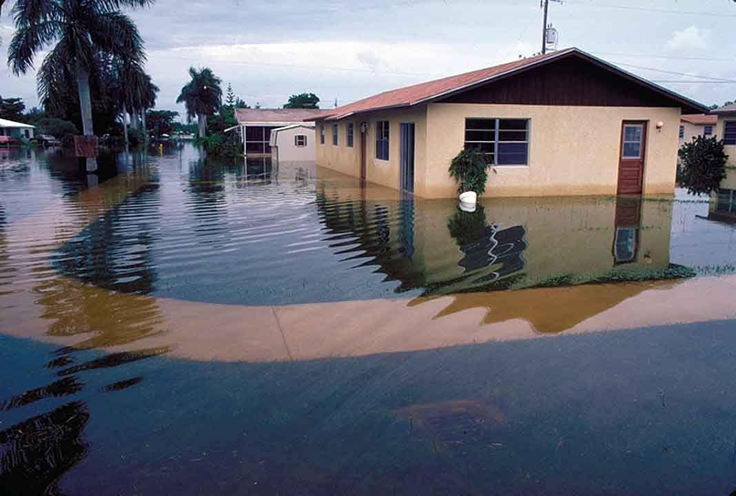
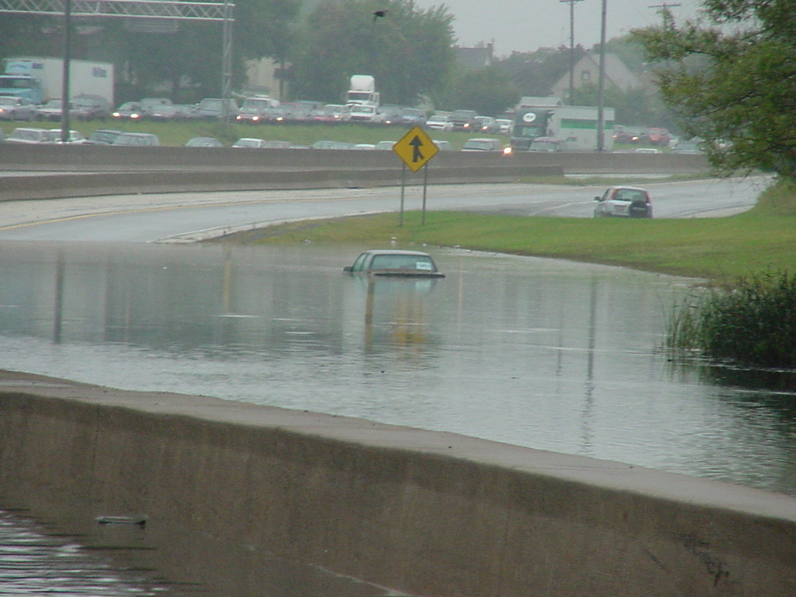
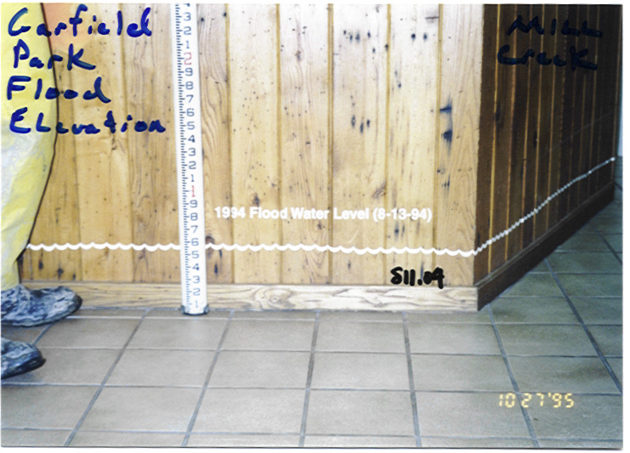
Model Validation
Independent check or “ground-truthing” of the calibrated model
Sources of validation data:
High water marks, debris lines
Pump station records
Photographs, aerial photos
Flooding complaint records
Newspaper articles
Insurance claims
Results from other studies & reports

Slide 10
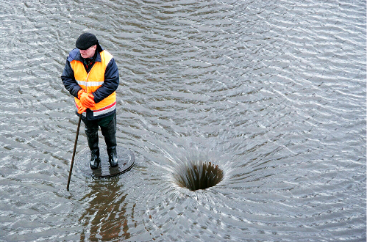
Model Verification
Flow is contained in the pipe/channel during small storms
But during the larger storm events…
Runoff overflows the pipe or channel banks
Streets and homes are flooded
Conveyance and storage properties are very different than low-flow conditions
Calibration measurements may be biased to small storms, modelers therefore must validate/verify their model for the big storms
Which requires modeling the “dual drainage” system…
Minor: active during all runoff producing events, it includes closed conduits (e.g., circular pipes and forcemains) and open channels (e.g., swales, roadside ditches, and creeks)
Major: active during the larger flood events when the minor system is overloaded (e.g., flooding in the curb/gutter along the road rights-of-way)

Slide 11
Verification (continued)
Relate flooding occurrence to a design storm event:
Interview residents and/or staff who are familiar with the area and its history
Identify chronic flooding problem areas
Estimate return period of flooding (e.g., 2-yr road flooding, 25-yr building flooding) = “Level of Service” evaluation
Model should indicate similar flooding occurrences for design storm events
Verification is not as objective or precise as calibration, but can lead to a credible model for high-flow conditions
Calibration and validation only confirm model results at selected points, whereas verification using a system-wide evaluation covers the entire study area

Slide 12
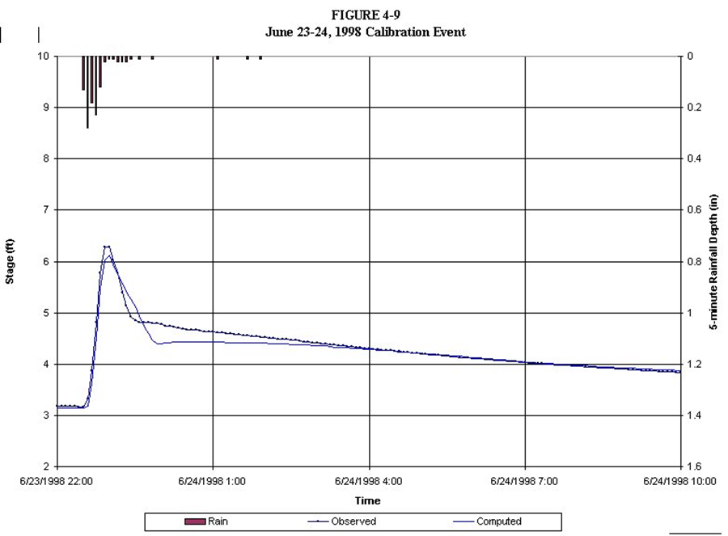
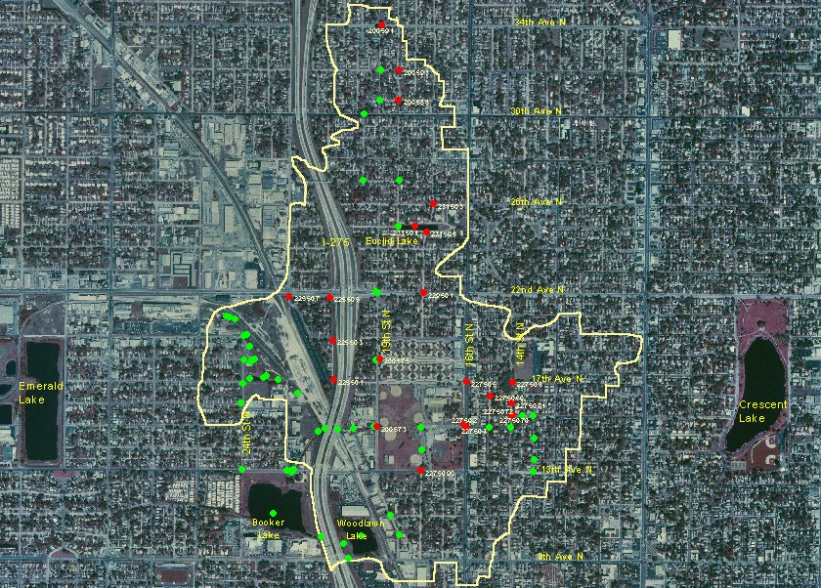
Example…
Point calibration and system-wide verification
Legend (25-yr Level of Service)
Road flooding
No road flooding
Calibration only confirms model results at a point in the system

Slide 13
Suggested Calibration Methodology
EWRI Congress 2025, EPA SWMM5 Workshop -- Model Calibration

Slide 14
Model Calibration Methodology
Before you begin calibrating the model, check that:
Model is debugged, representative of your largest design storm event or loading condition
Measured data have been reviewed
Sensitivity analysis has identified sensitive and insensitive parameters
Select candidate events:
Categorize by response type, seasonality, etc.
Separate into distinct flow regimes (e.g., small storms with flow in the main channel versus big storms that flow out-of-bank)
Hierarchy of calibration parameters:
Calibrate the hydrology first (match runoff volume)
Hydraulics second (match peaks and timing)
Save the water quality for last

Slide 15
Suggested Methodology
1. Select events with impervious response
Only impervious surfaces contribute runoff
Intense, small volume storm events
2. Calibrate impervious area parameters
Imperviousness, overland flow width, and impervious initial abstractions
Match total volume and hydrograph shape (peak and timing)
3. Select events with pervious response
Both impervious and pervious surfaces contribute runoff
Steady rain, large volume storm events
4. Calibrate pervious area parameters
Infiltration parameters, pervious initial abstractions, pervious roughness
Match total volume and hydrograph shape

Slide 16
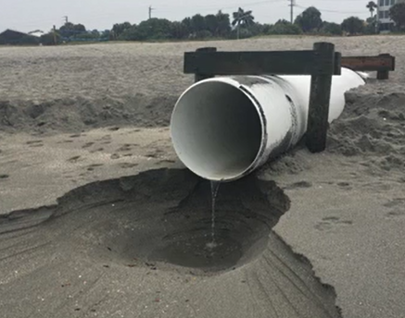
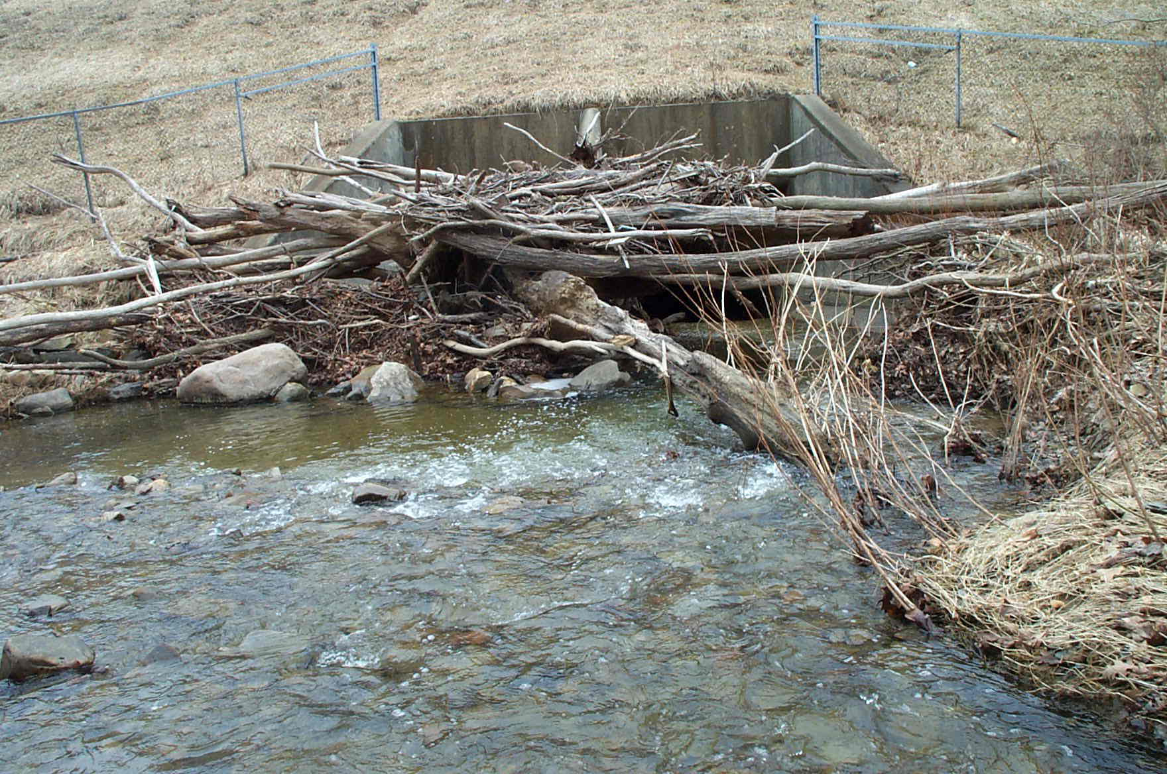
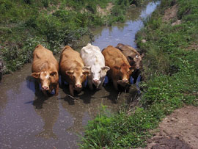
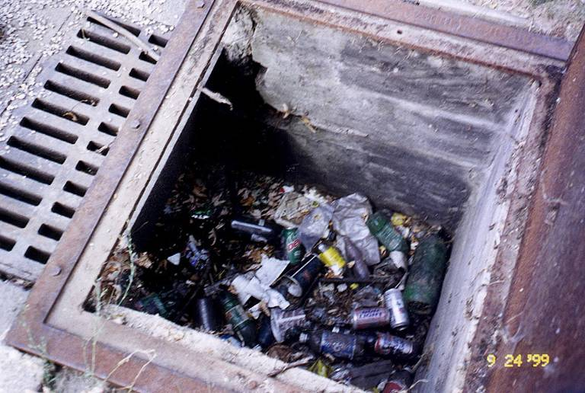
Suggested Methodology (continued)
5. Calibrate hydraulic parameters
Boundary conditions (tide, lake levels)
Base flow contributions (groundwater)
Channel/pipe roughness (vegetation, sediment)
Variable hydraulic conditions (blockage)

Slide 17
Suggested Methodology (continued)
6. Repeat steps 1-5 for all calibration events. The optimal set of calibration parameters will be based on how well you can:
Match total volume of flow
Match peak values of stage, flow, velocity
Match timing of the peaks
Match overall hydrograph shape
7. Validation
Test the worthiness of calibrated model parameters
Compare results to other flow or stage measurements
8. Verification
Test the worthiness of the calibrated/validated model
Compare to other anecdotal information for the really big events (i.e., where measurements may not be available)

Slide 18

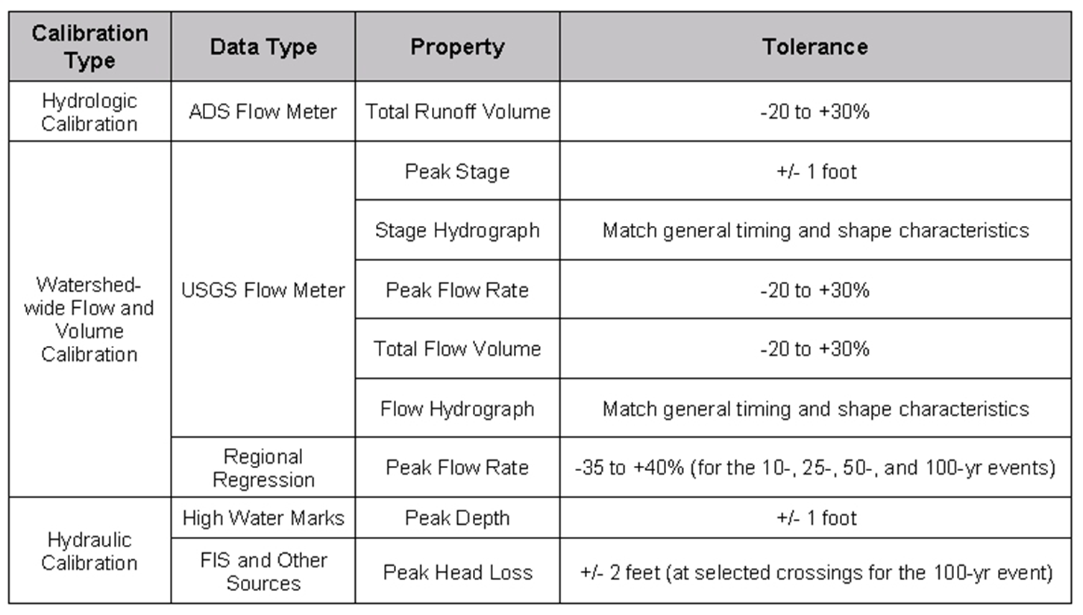
When is a Model Calibrated?
Criteria should be selected upfront, and possibly refined/negotiated during the calibration process
For additional insight, see CIWEM Code of Practice at https://www.ciwem.org/
This is what we used for a large master planning effort in northeast Ohio (c. 2004)…

Slide 19
Monitoring Program Data Review
EWRI Congress 2025, EPA SWMM5 Workshop -- Model Calibration

Slide 20
Verification of Measured Data
Screening rainfall and flow monitoring data is a key activity that precedes the calibration effort
Review with respect to:
Accuracy/quality
Extent of coverage (range of development type, drainage system characteristics, and hydrologic conditions)
Period of record
Selection of appropriate calibration datasets
Improves model credibility by helping to ensure that imperviousness, for example, will not be improperly calibrated to make up for bad flow data

Slide 21
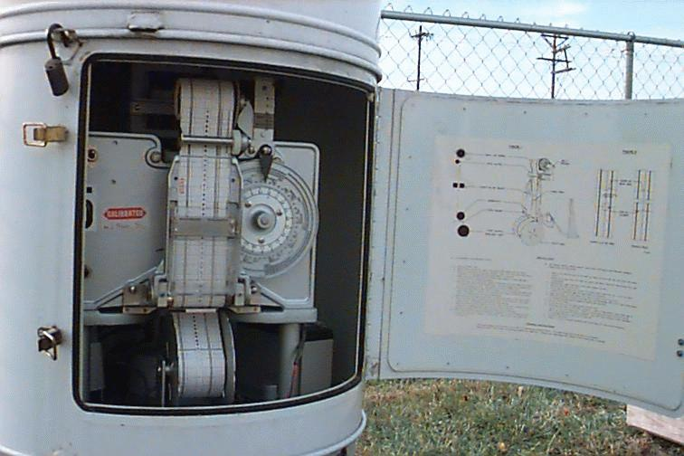
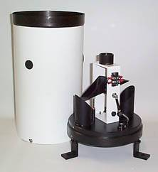
Rainfall Measurements
Point representation of area-wide process
Verify adequacy of rainfall data
Proximity to watershed (and orographic effects)
Number of gages
Extrapolate using daily gages and radar
Consider antecedent record
Operation and maintenance of equipment
Standard (non-recording) rain gage
Tipping bucket
Strip chart
Downloadable memory
Telemetry

Slide 22
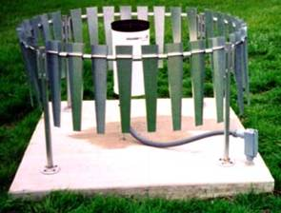
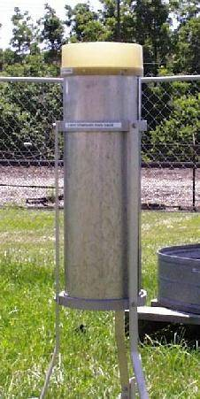
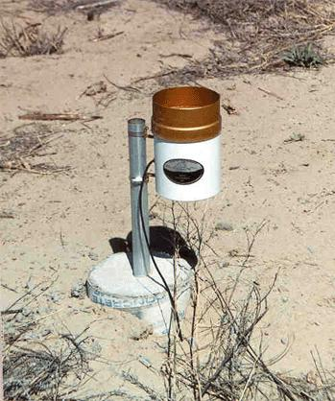
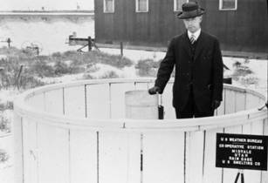
Rainfall Measurements (continued)
Location considerations
Obstructions
Wind effects
Ground splash
Security
Freezing, etc.
Operations & maintenance
Cleaning
Calibration
Standard protocols at the state/federal level (and regional datasets from local governments, water management agencies, etc.)

Slide 23
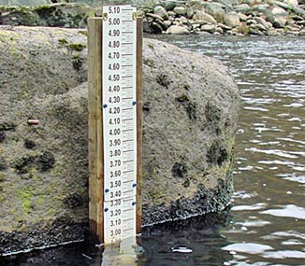
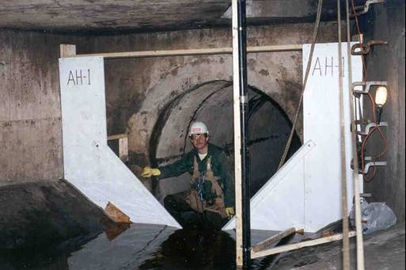
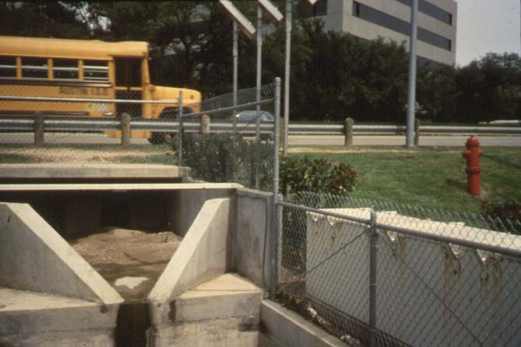
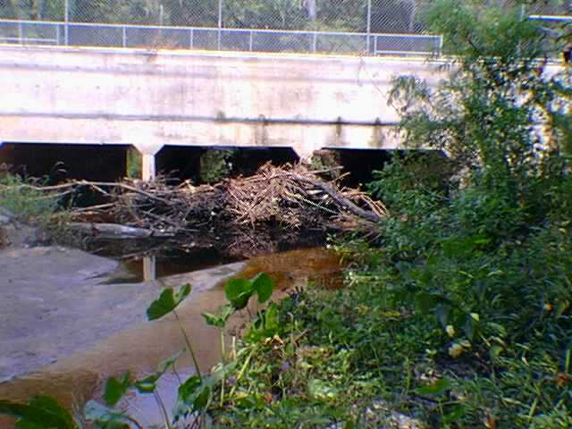
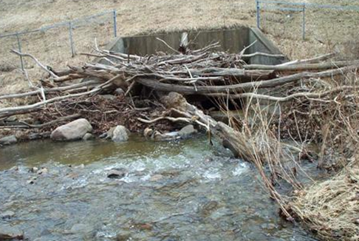
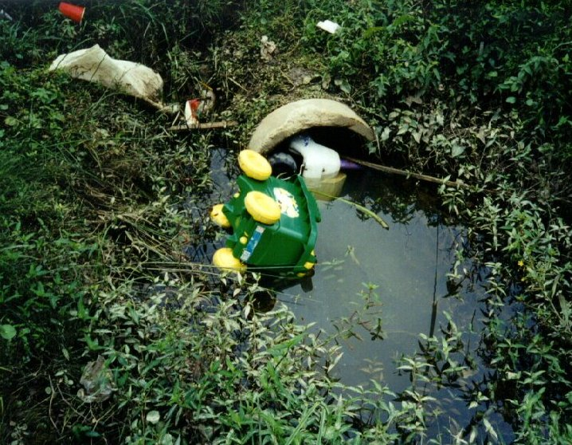
Flow Measurements
Verify adequacy of discharge/stage data
Period and homogeneity of record
Seasonal effects (e.g., baseflow, vegetation)
Operation and maintenance of equipment
Measurement method (e.g., stage, single-valued rating curve, velocity and depth)
And you never know what might happen during one of your calibration events…

Slide 24
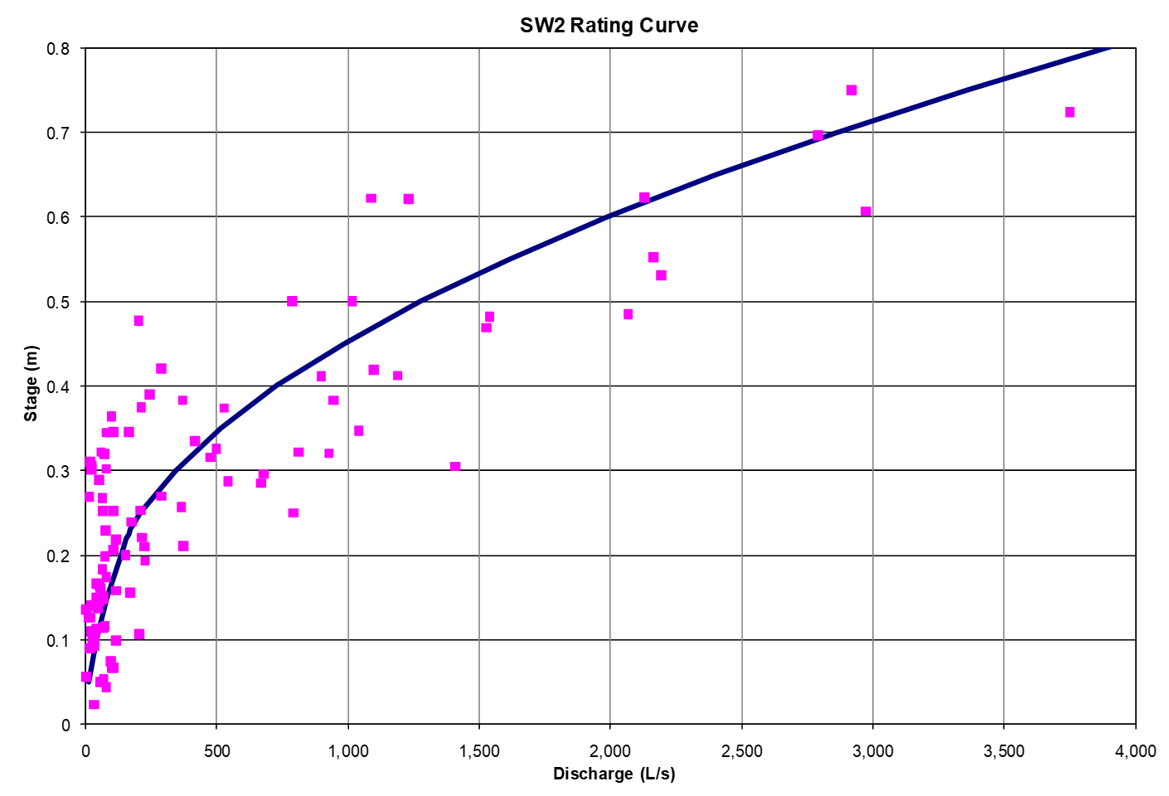
Streamflow Rating Curves
These are site-specific stage-discharge relationships
By measuring stage, the corresponding flowrate is determined from the rating curve and recorded as part of the observed time-series data
Developed from in-stream velocity-area measurements
Ideally from a wide range of flows in the channel
Should be updated when channel flow characteristics change
Curves may not include large flood event flows, or may feature wide scatter in field measurements (which is not conducive to a single-valued curve)

Slide 25
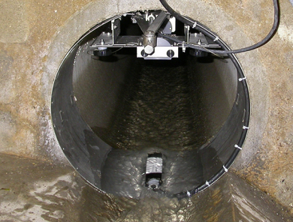
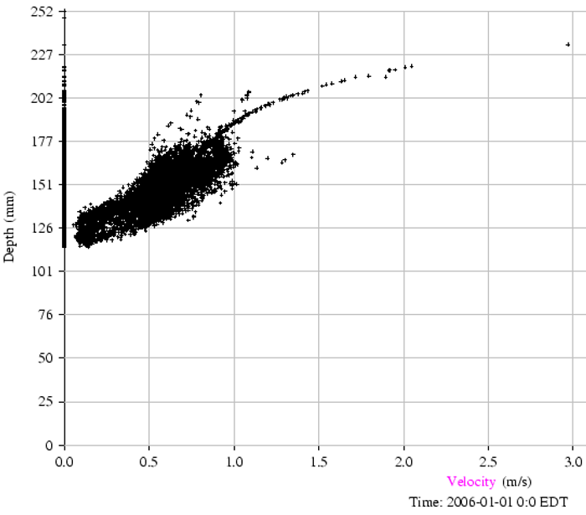
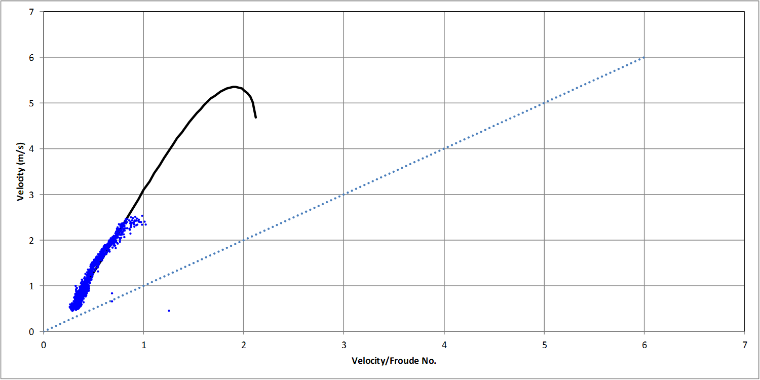

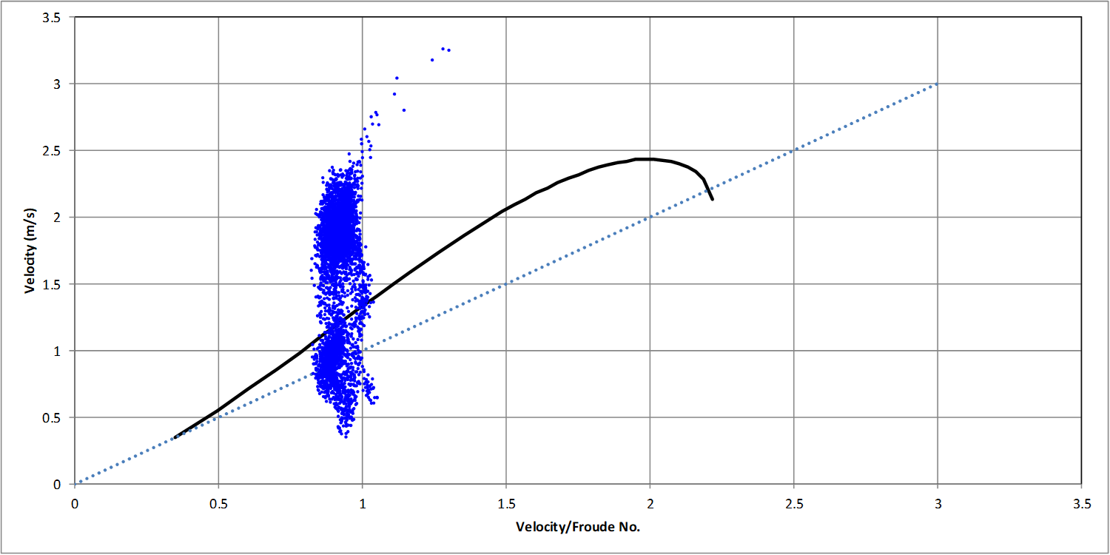

Sewer Flow Monitoring
Whether you hire a contractor or do it yourself, always check the data
At a minimum, compare with Manning’s formula
Replace or move the meter if you have bad data!
Depth-Velocity plots
Velocity-Velocity÷ Froude plots

Slide 26
Model Calibration Examples
EWRI Congress 2025, EPA SWMM5 Workshop -- Model Calibration

Slide 27
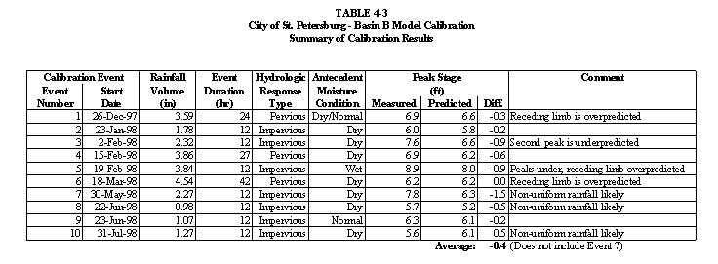
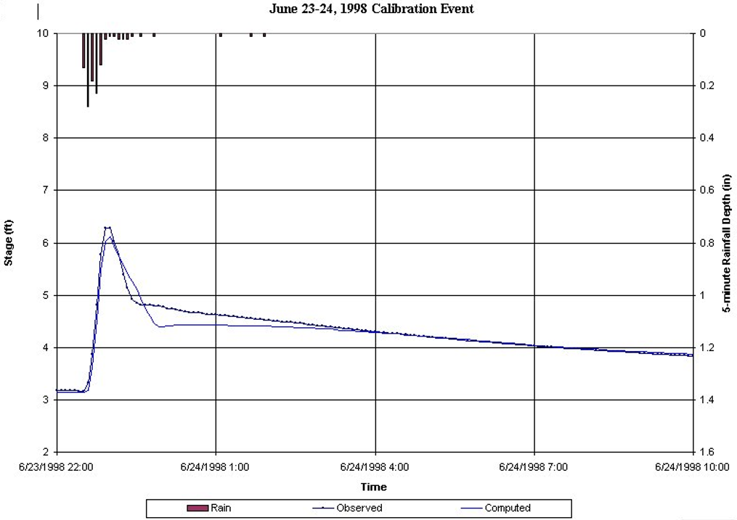
Single Event Examples

Slide 28
Continuous Simulation Examples

Slide 29
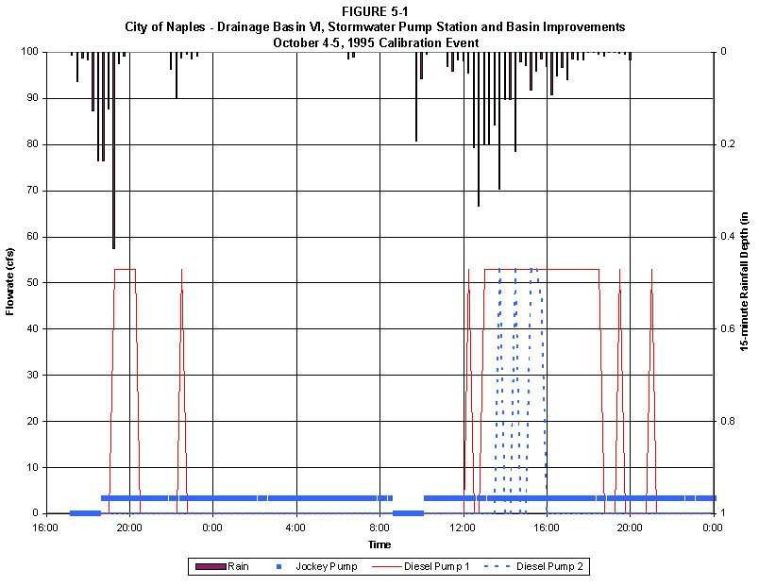
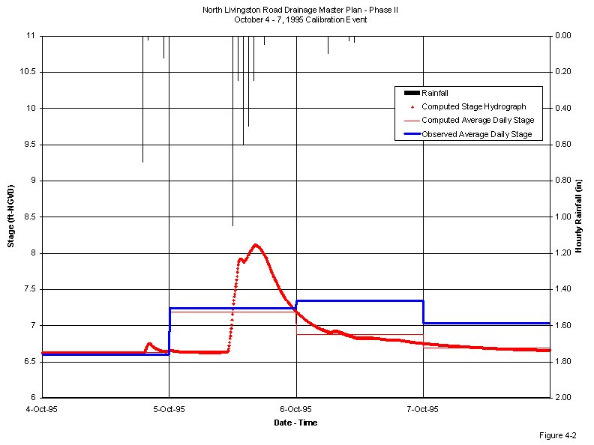
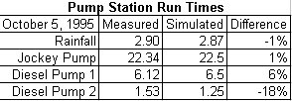
Calibration Affected by Measurement Limits
In lieu of flow measurements, match pump run times
Work with whatever time resolution is available…

Slide 30
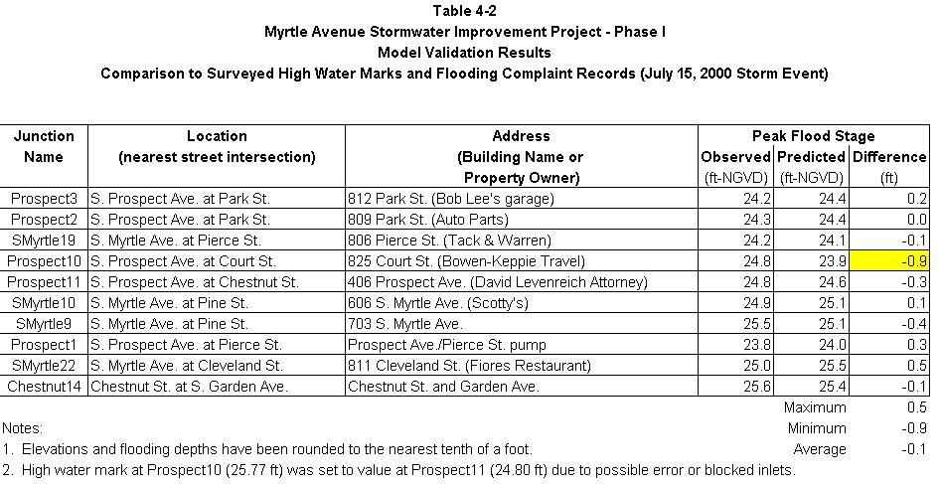
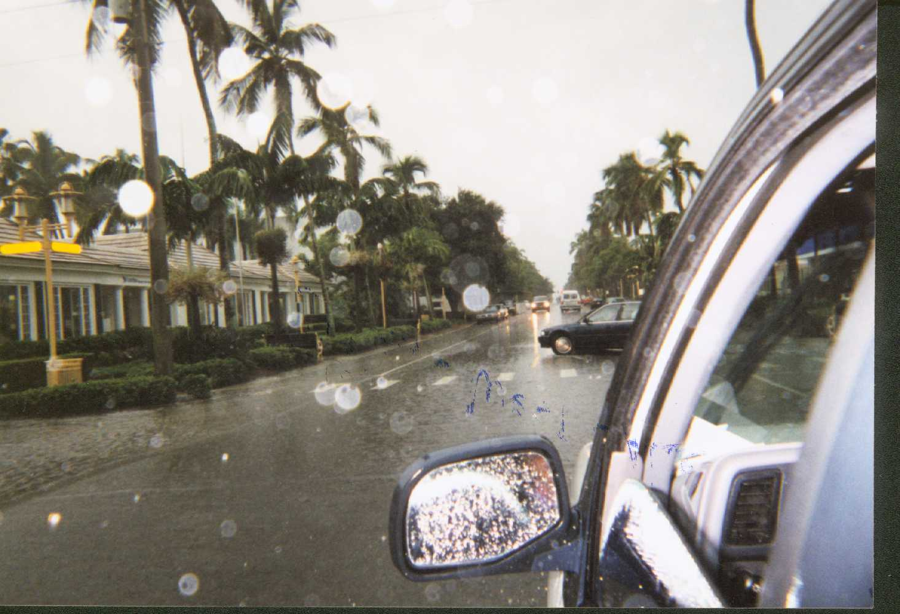
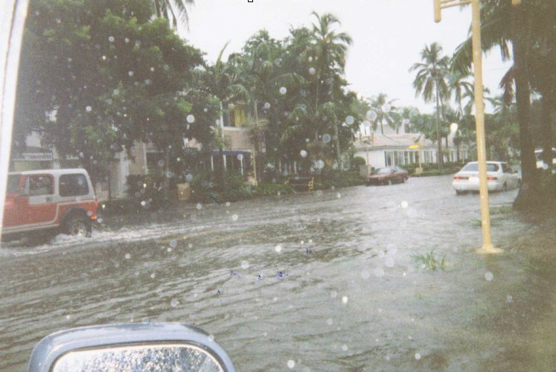
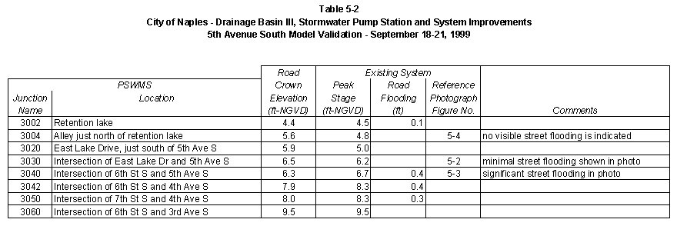
Validation – Comparison to High Water Marks
Junction 3030
Junction 3040
Figure 5-2
Figure 5-3

Slide 31
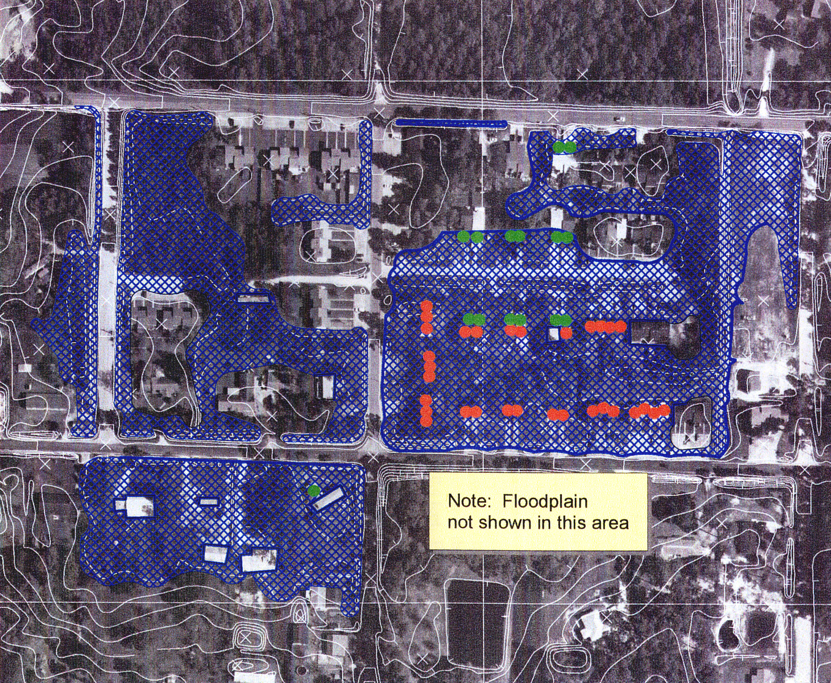
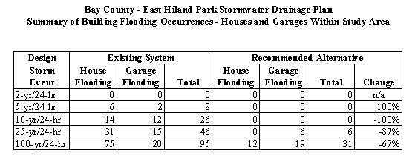
Validation – Match Chronic Flooding Problems
Count the number of impacted structures
Legend (25-yr Design Storm)
House flooding (n=31)
Garage flooding (n=15)

Slide 32
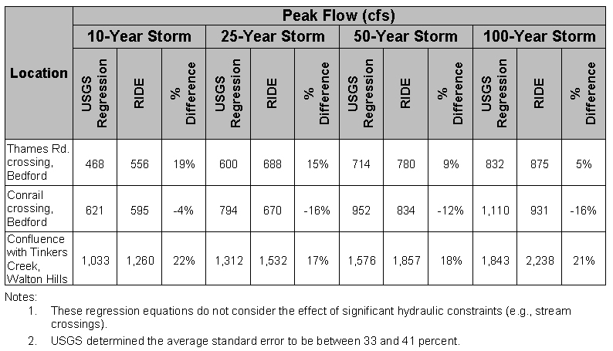
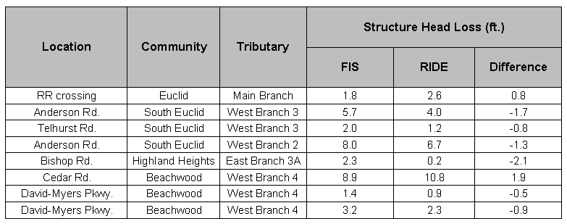
Validation – Comparison to Previous Studies
Compared to local USGS regression equations
Compared to headloss through culverts as reported in FEMA Flood Insurance Study

Slide 33
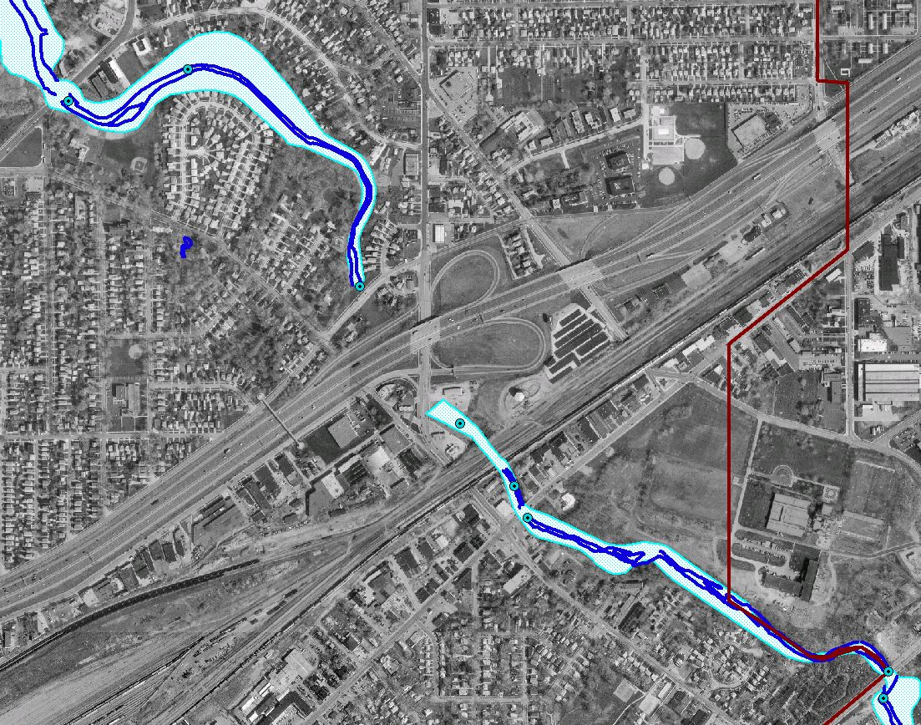
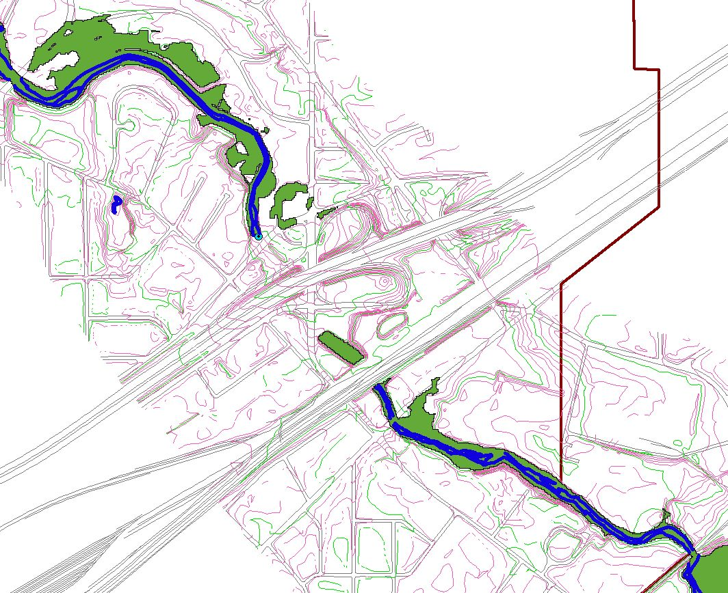
Validation – Match FEMA Floodplain
FEMA Floodplain
Computed 100-yr Floodplain

Slide 34
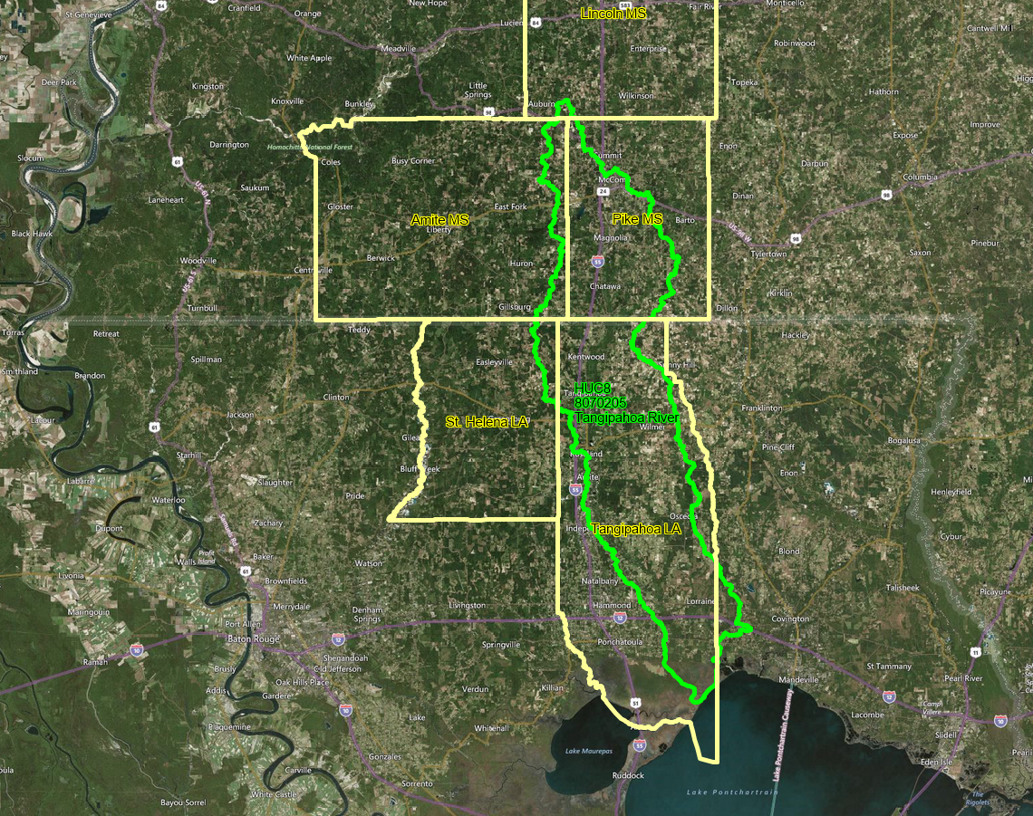
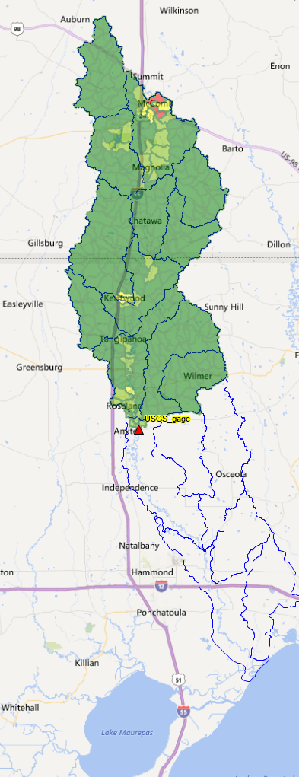
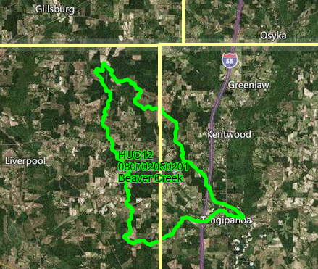
Calibration Example – Upper Tangipahoa River
Upper Tangipahoa River watershed
Mississippi
Louisiana
LA MS
Beaver Creek subwatershed

Slide 35
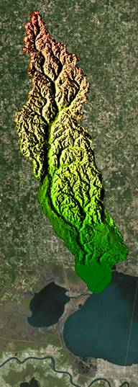






Rainfall, Flow, and Digital Topography Data
NCEI rainfall data (HPCP hourly, ASOS 1-minute)
USGS gage data (NWIS) and elevation data (TNM, 30-ft)

Slide 36


Successful Calibration?
Results based on standard parameter values applied with NLCD database – further refinements would use SRTC tool

Slide 37


A Different Example
successful calibration?
with groundwater
NO! (don’t ignore groundwater)

Slide 38


Another Example…
Original “Calibrated” Groundwater Model
Revised Calibration

Slide 39

Yet Another Watershed…
Chronic flooding problem area in central Nigeria, at the confluence of three rivers:
Niger River
River Gurara
Benue River
Note: Digital datasets often end at the country border, so data splicing/merging may be necessary

Slide 40

1D watershed model
2D submodel
2D floodplain delineation

Slide 41
Thank you for your attention… any questions?
EWRI Congress 2025, EPA SWMM5 Workshop -- LID Modeling
Mike Gregory, P.Eng., PE mike@chiwater.com

